Slide 1
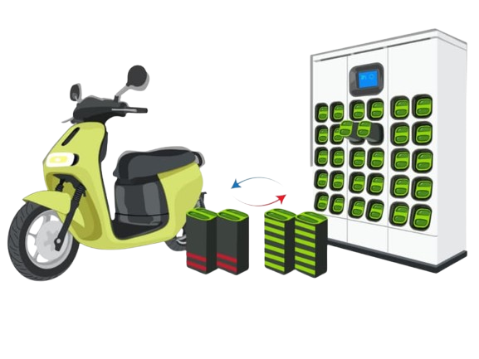
E-Bike Battery Swapping Station

Slide 2
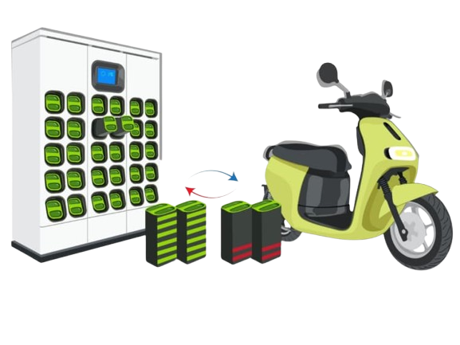
TABLE OF CONTENTS
03
01
04
02
Swapping Station Workflow
Concept of E-Bike Battery Swapping Station
Operational Workflow
System Overview
05
PCB Overview
06
07
PCB Specifications
Detailed PCB Components and Functions
Notes:
Swapping Stati

Slide 3
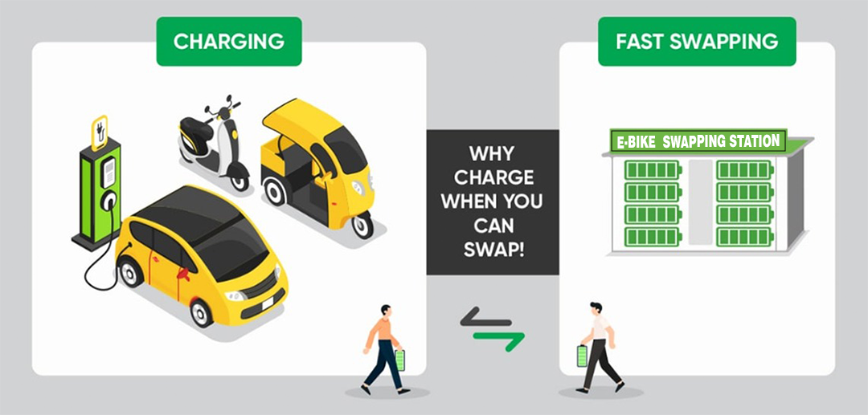
E-Bike Battery Swapping Station

Slide 4
Concept of E-Bike Battery Swapping Station
A facility or system where e-bike users can quickly exchange their depleted batteries for fully charged ones.
Reduces downtime associated with charging.
Often automated and accessible via membership or pay-per-use models.

Slide 5
System Overview
Capacity
The swapping station has 12 slots for e-bike batteries.
Dashboard Features
Displays voltage, current, battery charge percentage, charger status indication, temperature of batteries, slot temperature, payment option and door open/close option.

Slide 6
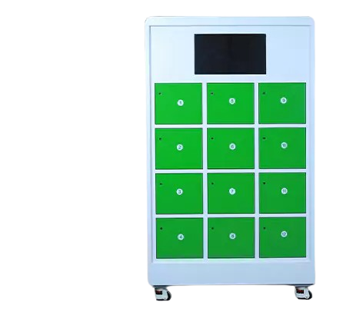
Battery Swapping Station Workflow
System Overview
Components
Slaves (12 Slots): Individual slot controllers for sensors and locks.
Master: Central controller for all slaves.
Server: Processes data and coordinates system-wide operations.

Slide 7
Battery Swapping Station Workflow
Connected Sensors and Devices:
ESP-NOW: Communication between slaves and the master for all slaves.
WebSockets: Communication between the master and the server.
Data Collection and Transmission:
Collects data from sensors and the CAN module. Transmits this data to the master via the ESP-NOW protocol.

Slide 8
Battery Swapping Station Workflow
Slave Unit Functionality
Connected Sensors and Devices:
CAN Module: Retrieves battery data (SoC, voltage, current) from the Battery Management System (BMS).
Temperature Sensor: Monitors slot temperature for safety.
Electromagnetic Lock: Secures and operates slot doors.

Slide 9
Battery Swapping Station Workflow
Master Unit Functionality
Data Handling: Receives data from slaves via ESP-NOW and forwards it to the server using WebSockets.
Command Execution: Receives slot operation requests (e.g., open door) from the server. Sends these commands to the respective slave for execution.

Slide 10
Battery Swapping Station Workflow
Server Functionality
Data Processing: Analyzes sensor and battery data for system monitoring. Determines slot status and battery availability for swapping.
Request Management: Sends lock operation requests (e.g., open a slot door) to the master.

Slide 11
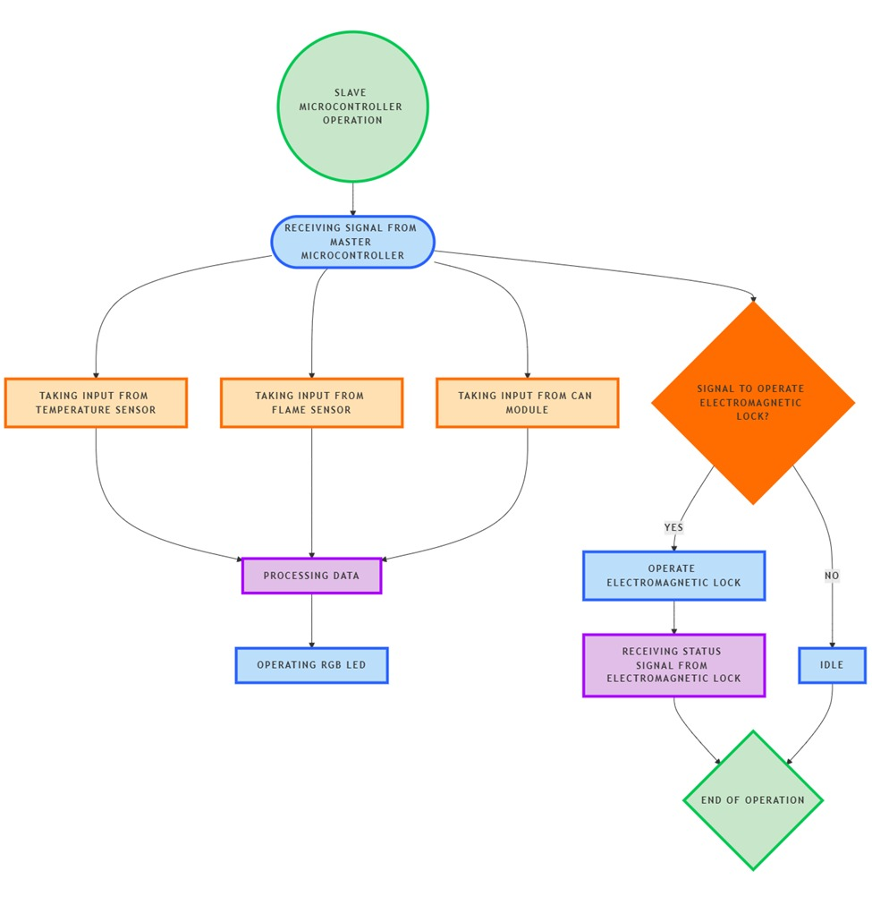
Operational Workflow

Slide 12
Operational Workflow
1. Data Collection and Transmission
Each slave collects data (battery, temperature and flame) and forwards it to the master.
The master relays this data to the server.

Slide 13
Operational Workflow
2. Battery Charging Status
Server processes battery SoC and updates status on web portal using an LED which when:
* Green: shows fully charged and ready for swapping.
* Yellow: shows charging in progress.

Slide 14
Operational Workflow
3. Lock Operation
Server sends an open request for a specific slot to the master.
Master forwards the request to the corresponding slave.
Slave operates the electromagnetic lock to open the slot door.

Slide 15
Key Features
1. Real-Time Monitoring
3. Automated Lock Control
Continuous data transmission for accurate monitoring.
Remote slot door operation ensures efficient management.
2. User-Friendly Indicators
4. Safe and Reliable
Battery charging status updation using LED on web portal.
Flame and aerosol sensors enhance system safety.

Slide 16
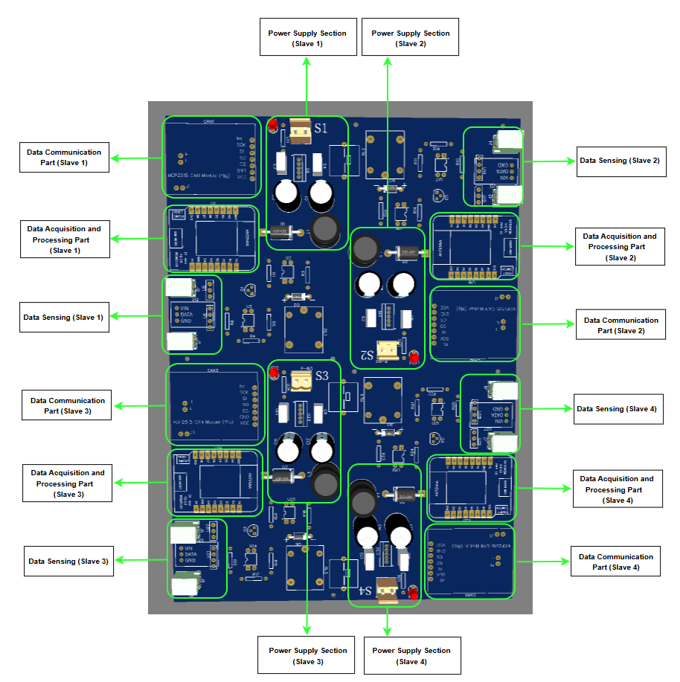
PCB Overview – The Heart of the Charging Station
Why the PCB is Crucial?
1. Centralized Control: Acts as the intermediary between the master and individual slot components.
2. Real-Time Processing: Ensures accurate and timely decisions (e.g., LED indicators, lock operations).
3. Reliability: Robust design for uninterrupted operation in a demanding environment.

Slide 17
Key Features
Scalable Design
Modular architecture allows easy addition or replacement of PCBs.
Efficient Communication
Power Optimization
High-speed data transfer with minimal latency via ESP-NOW.
Individual power sections ensure stable operation of each slot.
Safety Integration
Supports real-time monitoring through temperature and flame sensors.

Slide 18
PCB Specifications
Slot Management
Integration
Combines data sensing, communication, processing, and power supply for efficient operation.
1. Each PCB controls 4 slots.
2. A total of 3 PCBs are installed in the charging station to manage 12 slots.

Slide 19
Detailed PCB Components and Functions
3. Data Acquisition and Processing Part
1. Power Supply Section
Dedicated sections for each slot.
Provides the necessary power to sensors, locks, and communication modules.
Collects data from:
CAN module
Temperature sensor
Flame sensor
Processes this data for forwarding to the master.
2. Data Communication Part
4. Data Sensing Section
Handles communication between the PCB and the master controller.
Facilitates ESP-NOW protocol for seamless data exchange.
Connected to:
CAN Module
Temperature Sensor
Flame Sensor
Lock Status Sense

Slide 20
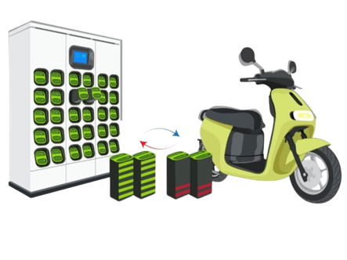
THANKS!

